Slide 1
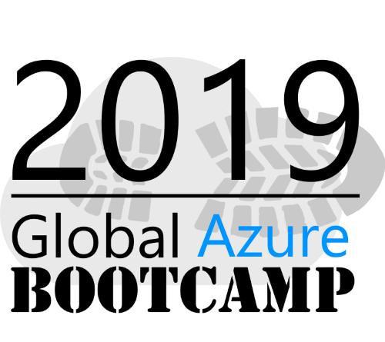
JOHANNESBURG
27TH APRIL 2019
Creating, publishing and using NuGet packages with Azure
DevOps
Dustin McDonald
Mobile Developer @dustin_dev github.com/dlmcdonald

Slide 2

About this session
Introduction to NuGet Packages
Setting up Azure DevOps with a custom package feed
Creating a NuGet package
Adding some basic CI/CD for your package
Using your new NuGet package

Slide 3
Let’s talk about Code reuse.

Slide 4


Slide 5
Let’s talk about Code reuse.

Slide 6

Advantages of making NuGet Packages
Central location for your shared libraries
Versioning
Simplified dependency management
Team collaboration

Slide 7

Setting up Azure DevOps

Slide 8
Setting up Azure DevOps
Create a new project
Create a new package feed
Create a new build definition (Restore, build, pack, push)

Slide 9
Creating a NuGet package

Slide 10
Creating a NuGet package
Create your library project
Create nuspec file
Configure dependencies
Configure output files

Slide 11
Putting it all together

Slide 12
Putting it all together
Point the NuGet Pack task the nuspec file
Configure the NuGet Push task to your package feed
?????
Profit

Slide 13
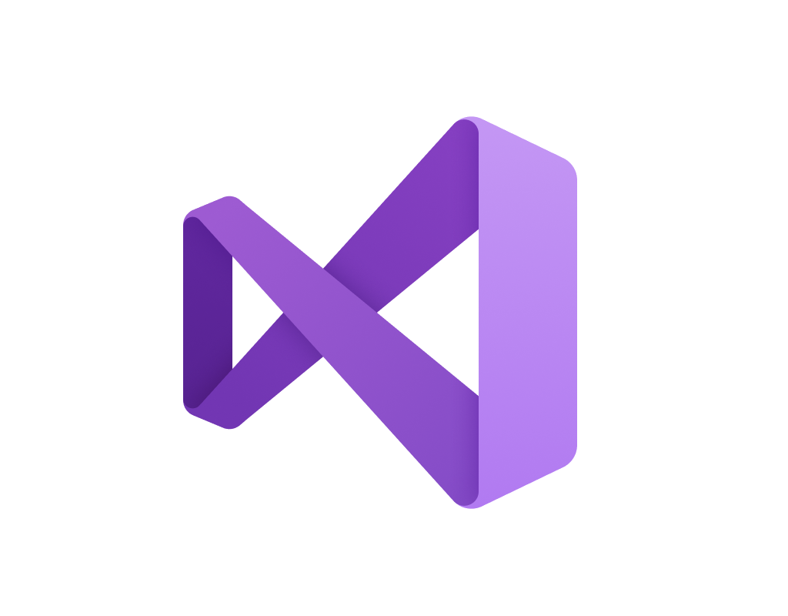
Using your NuGet package

Slide 14
Using your NuGet package
Configure any authentication on your package feed
Add your new feed via NuGet CLI
Install into your project with NuGet package manager

Slide 15
Thank you!
Creating, publishing and using NuGet packages with Azure
DevOps
Dustin McDonald
Mobile Developer @dustin_dev github.com/dlmcdonald

